Slide 1

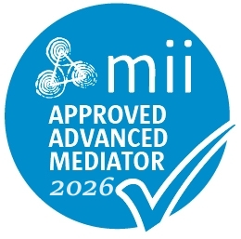
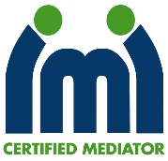
From Mediator to Business Owner:
Building a sustainable practice
Ber Barry-Murray, M.Ed., BCL, BA
Advanced Mediator, Mediators’ Institute Ireland
Certified Mediator, International Mediators Institute

Slide 2
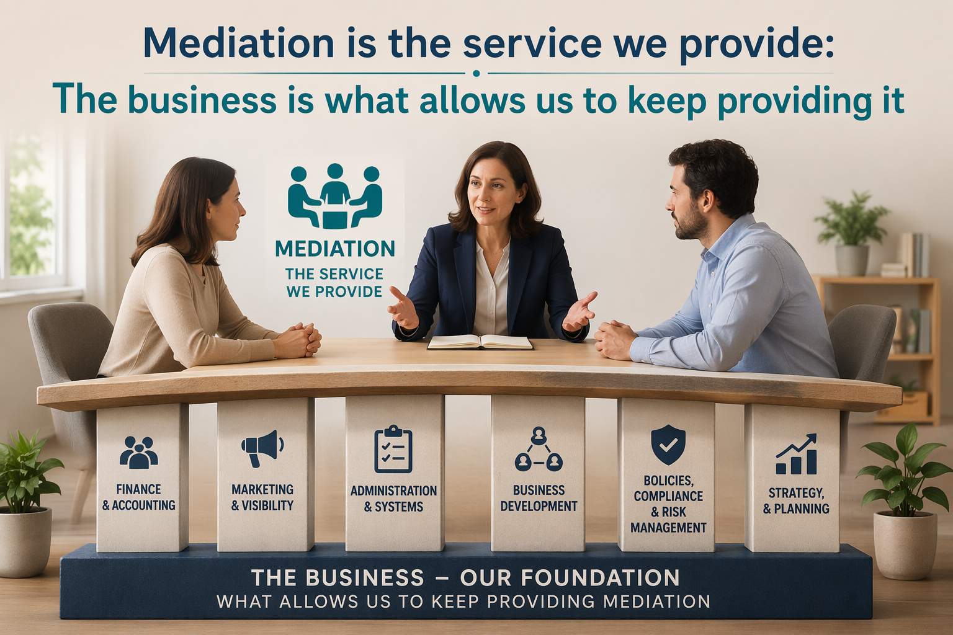

Slide 3
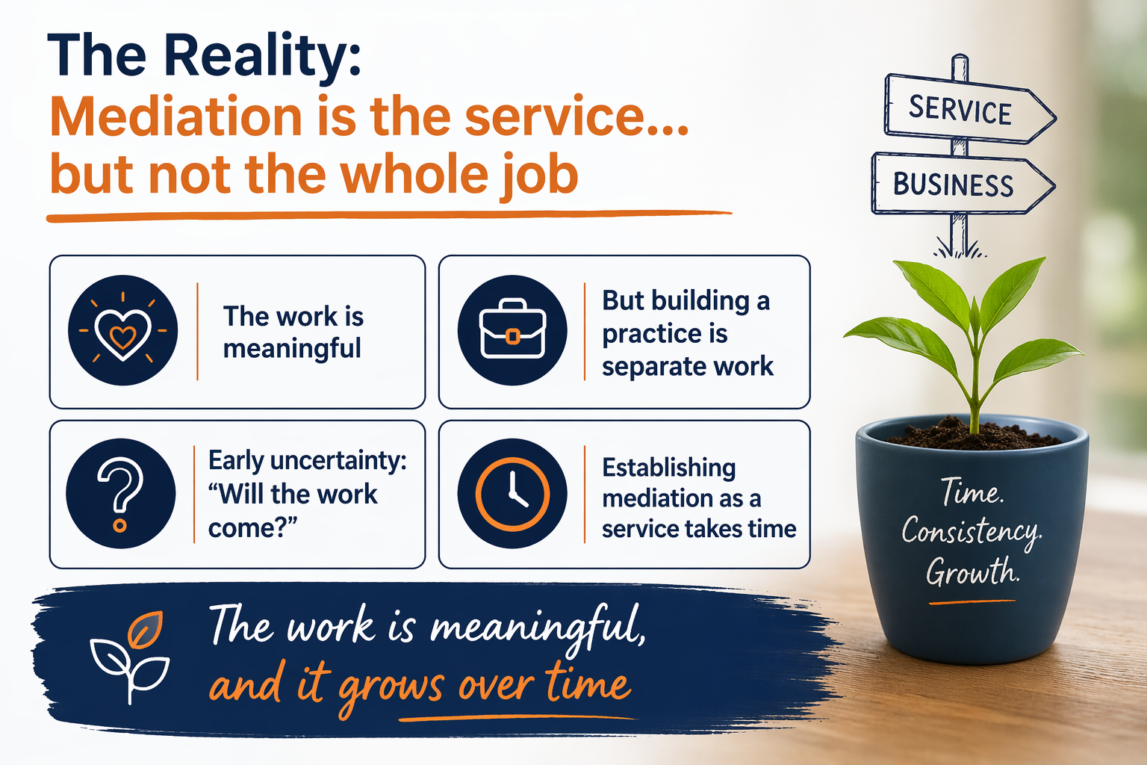

Slide 4
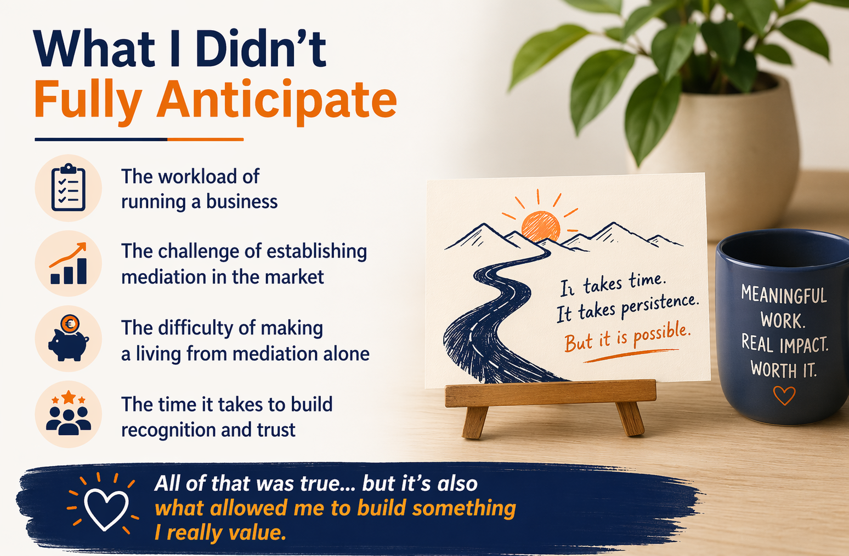

Slide 5
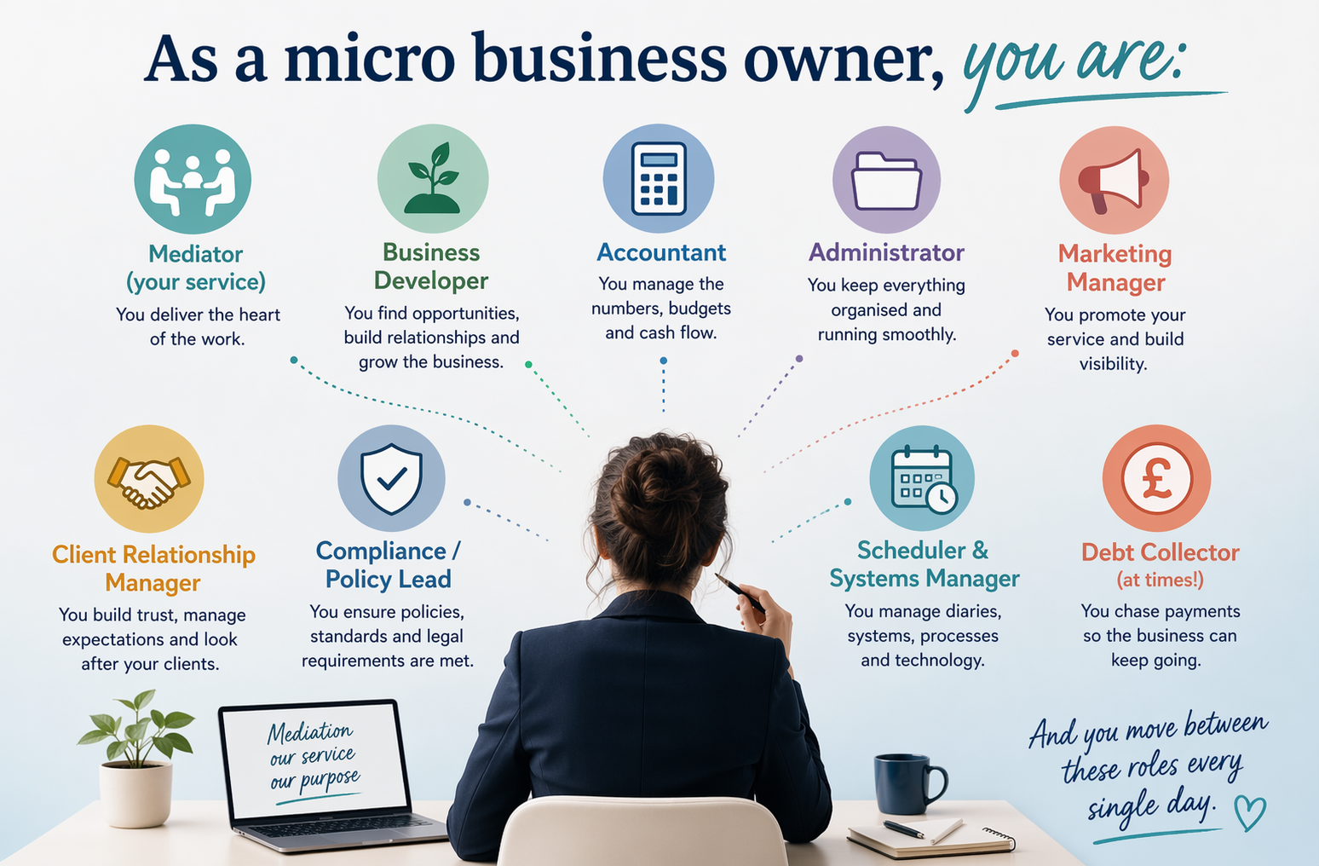
Notes:
This gives the work it variety and independence

Slide 6
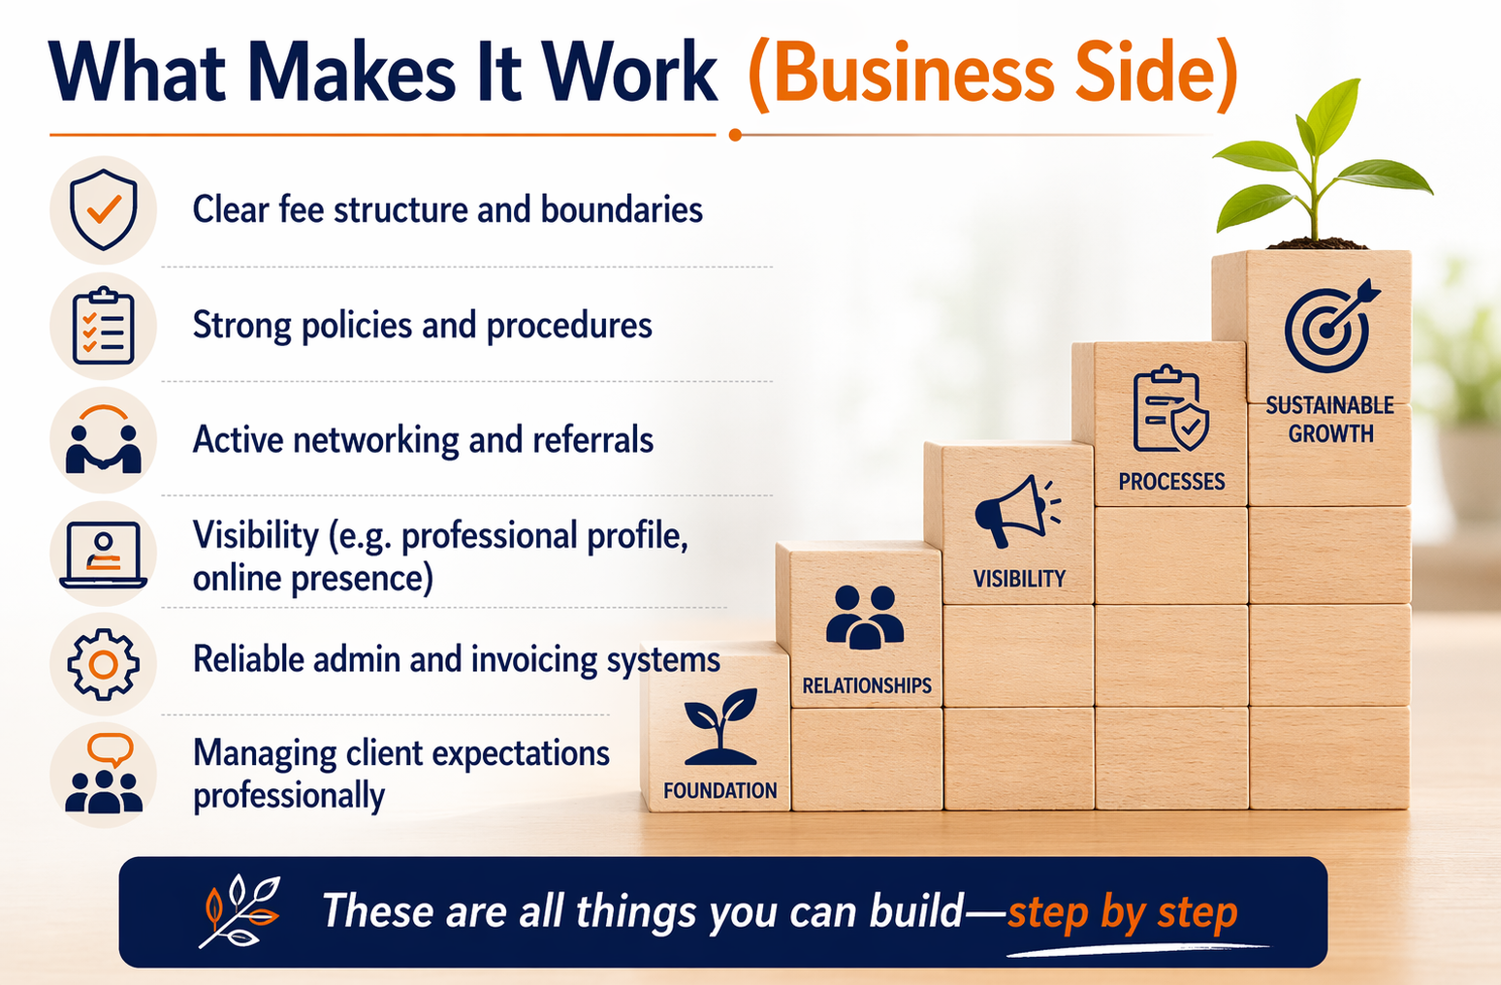

Slide 7
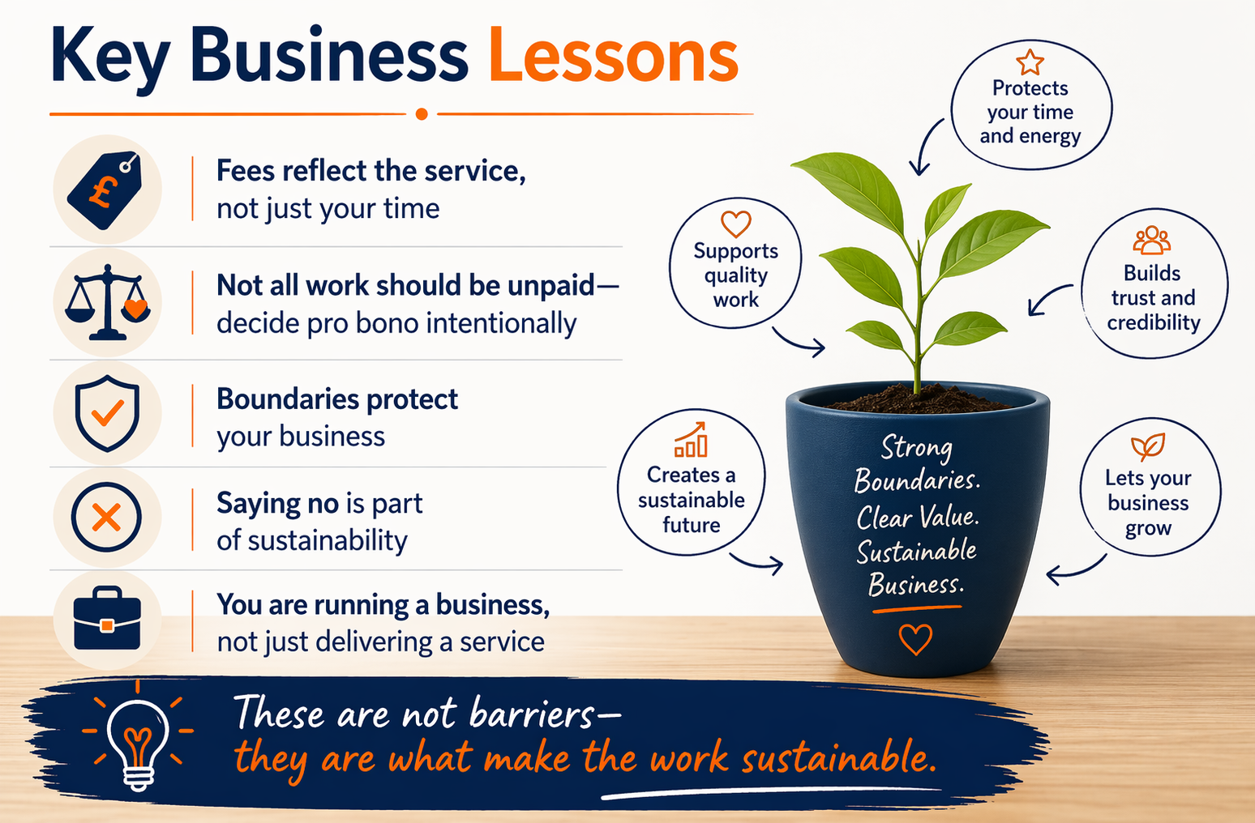

Slide 8
